Slide 1

Stack Overflow Developer Survey Analysis
A Comprehensive Analysis of Developer Trends and Insights
Author: Olaseni Omokungbe

Slide 2



OUTLINE
Executive Summary
Introduction
Methodology
Results
Visualization – Charts
Dashboard
Discussion
Findings & Implications
Conclusion
Appendix

Slide 3

EXECUTIVE SUMMARY
The Stack Overflow Developer Survey provides critical insights into global developer trends.
Key trends were identified in programming languages, databases, platforms, and demographics.
Python, JavaScript, and Java dominate current programming use.
Rising interest in Rust and TypeScript for future projects.
MySQL and PostgreSQL lead among databases, with NoSQL on the rise.
Demographic analysis highlights a diverse respondent base, with a majority in the 25–34 age group.
Developers increasingly prioritize cloud-native tools and AI-ready platforms.
The analysis provides actionable insights for hiring managers, educators, and technology strategists.

Slide 4

INTRODUCTION
This project analyzes the Stack Overflow Developer Survey to uncover key trends in the global developer ecosystem.
The purpose is to provide actionable insights for decision-makers, including hiring managers, educators, and technology leaders.
The analysis focuses on current and future technology trends, developer demographics, and preferences across programming languages, databases, and platforms.
The target audience includes industry professionals, educators, and organizations seeking to understand developer needs and market trends.
Data-driven insights help refine hiring strategies, technology adoption, and curriculum development.
Understanding developer demographics aids in aligning technology roadmaps with user preferences.

Slide 5

METHODOLOGY
The dataset used for analysis is the Stack Overflow Developer Survey, a comprehensive global dataset from 2024.
Data was collected through an extensive online survey targeting developers and technology professionals worldwide.
Key data wrangling steps included:
Cleaning and normalizing the data to handle missing or inconsistent entries.
Removing duplicate rows and imputing missing values where necessary.
Data was analyzed using Python, IBM Cognos Analytics, and Google Looker Studio for visualizations.
Bar charts, stacked charts, scatter plots, and dashboards were utilized for clear insights.
The analysis focused on programming languages, databases, demographics, and future trends.

Slide 6
RESULTS
Programming Language Trends
Current Trends: The top 10 programming languages used by respondents include Python, JavaScript, and Java, with Python leading due to its versatility in data science and web development.
Future Trends: Respondents expressed a strong desire to learn Go, Rust, and TypeScript, indicating a shift towards modern and efficient languages.
Database Trends
Current Use: SQL-based databases like MySQL, PostgreSQL, and SQLite dominate usage.
Future Demand: Cloud-based databases, such as Firebase and Amazon DynamoDB, are gaining popularity for their scalability.
Demographics
Age Groups: The majority of respondents are aged 25-34, reflecting the tech industry's younger workforce.
Education Levels: Most respondents have a Bachelor's or equivalent degree, with a growing number pursuing self-learning paths.
Compensation and Satisfaction
Insights: Higher compensation is correlated with job satisfaction, particularly among developers with extensive experience.
Key Dashboards
Current Technology Usage: Visualizations show widespread adoption of established tools like Git, IBM Cognos analytics, and Docker.
Future Technology Trends: Respondents aim to adopt cloud platforms and advanced AI tools.
Demographics: Regional data highlights the largest developer populations in the USA, India, and Germany.

Slide 7
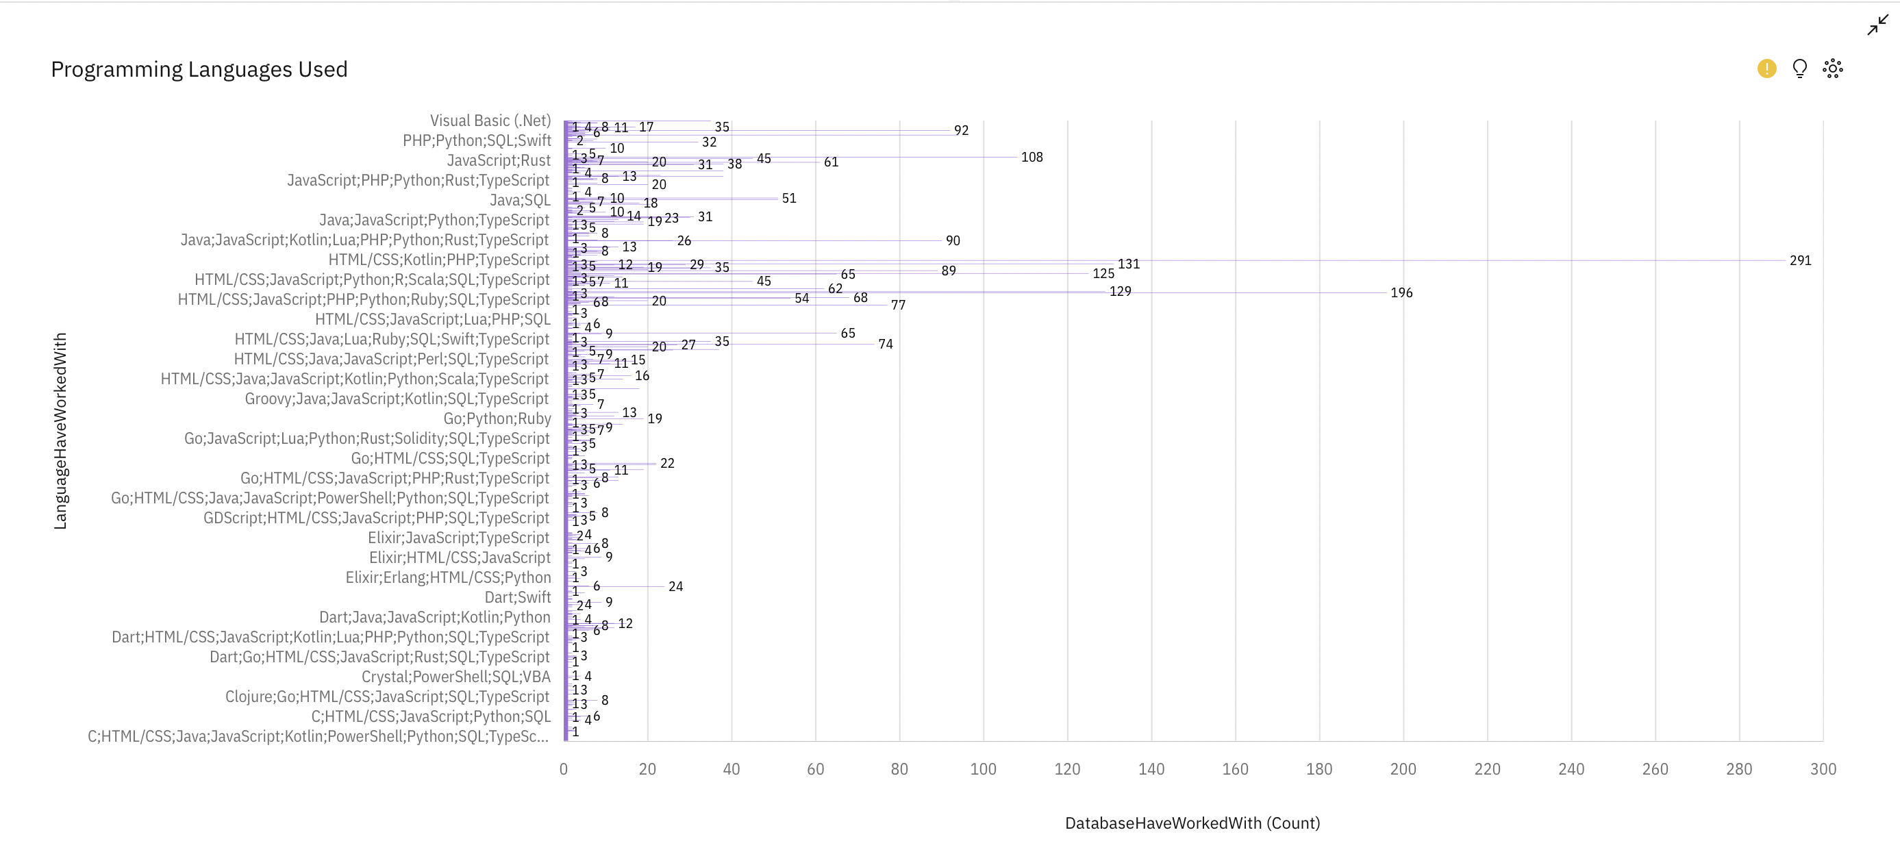
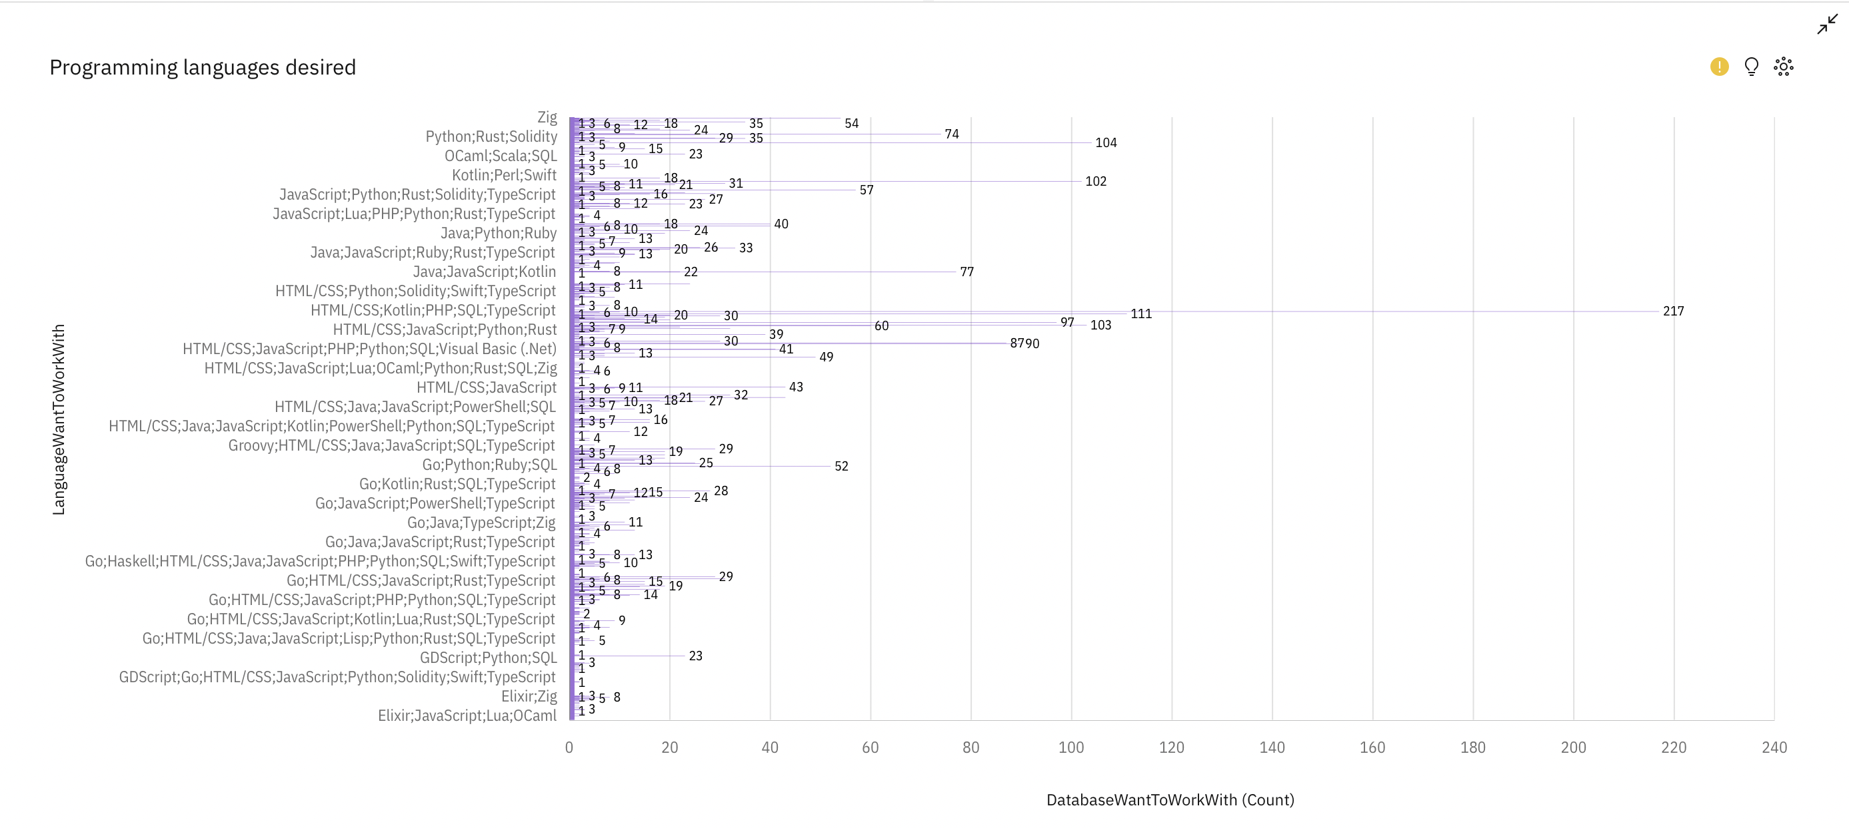
PROGRAMMING LANGUAGE TRENDS
Current Year
Next Year

Slide 8
PROGRAMMING LANGUAGE TRENDS - FINDINGS & IMPLICATIONS
Findings
Dominance of Popular Languages:
Languages like JavaScript, Python, and SQL continue to dominate both current and desired usage, indicating their widespread adoption across industries.
Emerging Trends:
Growth in interest for newer or specialized languages like Rust and Kotlin for future projects showcases a shift toward performance and developer-friendly technologies.
Decline in Traditional Languages:
Older languages like PHP and Visual Basic show reduced preference, indicating a shift away from legacy technologies.
Implications
Upskilling Opportunities:
Developers should prioritize learning in-demand languages like Python and JavaScript to stay competitive in the market.
Focus for Organizations:
Businesses need to align their tech stack with developer preferences for better talent acquisition and retention.
Educational Insights:
Training institutions can tailor their courses to include emerging languages like Kotlin and Rust to meet future industry needs.

Slide 9
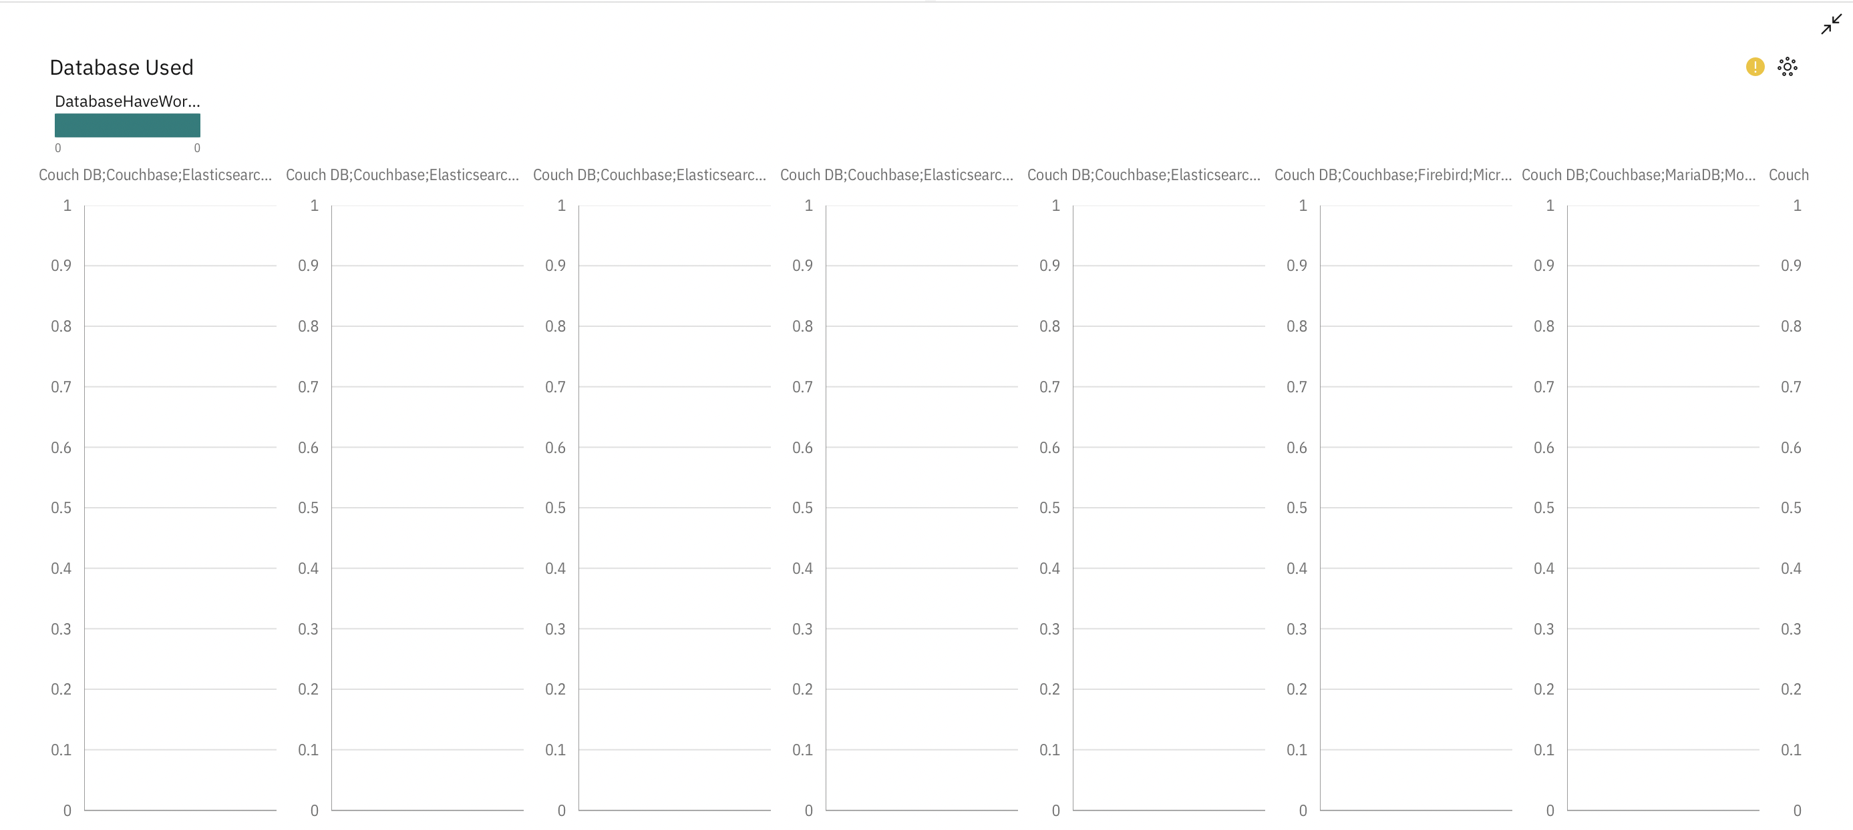
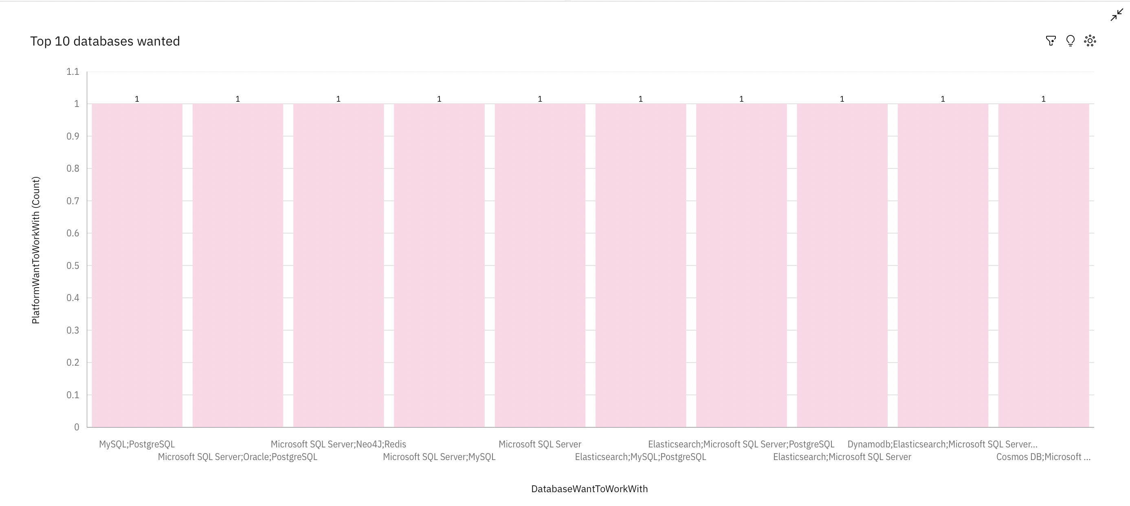
DATABASE TRENDS
Current Year
Next Year

Slide 10
DATABASE TRENDS - FINDINGS & IMPLICATIONS
Findings
Database Usage Insights: The survey indicates that Microsoft SQL Server, MySQL, and PostgreSQL dominate the database preferences among developers currently.
Emerging Preferences: Databases like Elasticsearch and Redis show a significant rise in popularity, indicating developers are exploring diverse options for specific use cases.
Future Interest: Developers have expressed increased interest in learning NoSQL databases like DynamoDB and Cosmos DB, hinting at growing adoption in non-relational data handling.
Implications
Skill Development Needs: Organizations should invest in training for emerging database technologies to keep their teams updated with industry trends.
Market Trends: The growth of interest in NoSQL databases reflects the need for scalable and flexible data solutions. Companies should consider these databases for high-velocity data applications.
Market Trends: The growth of interest in NoSQL databases reflects the need for scalable and flexible data solutions. Companies should consider these databases for high-velocity data applications.

Slide 11

DASHBOARD
<Please present your dashboard in the following slides.>

Slide 12
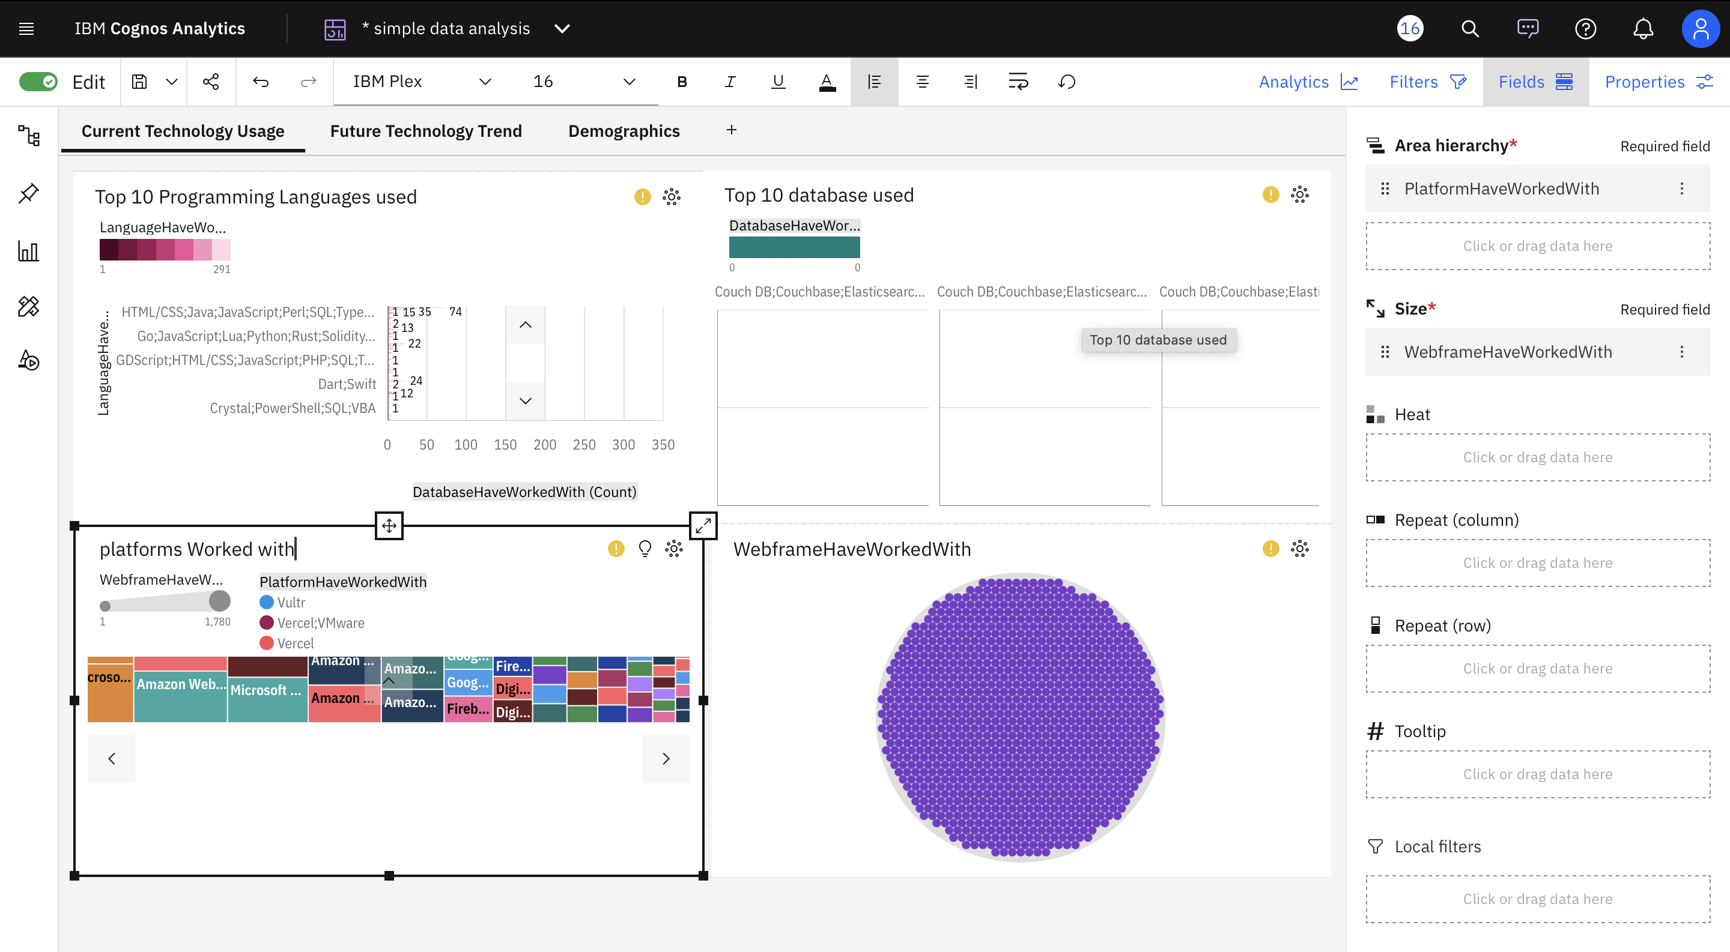
DASHBOARD TAB 1
Screenshot of dashboard tab 1 goes here

Slide 13
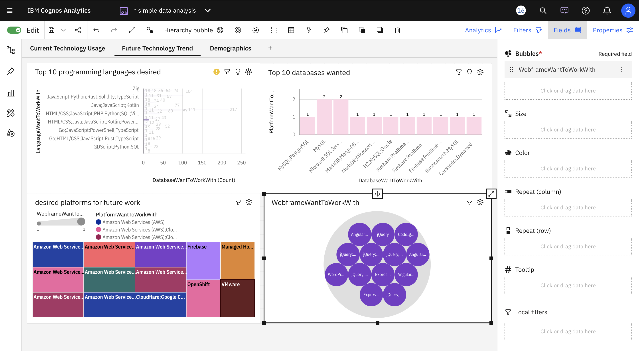
DASHBOARD TAB 2

Slide 14
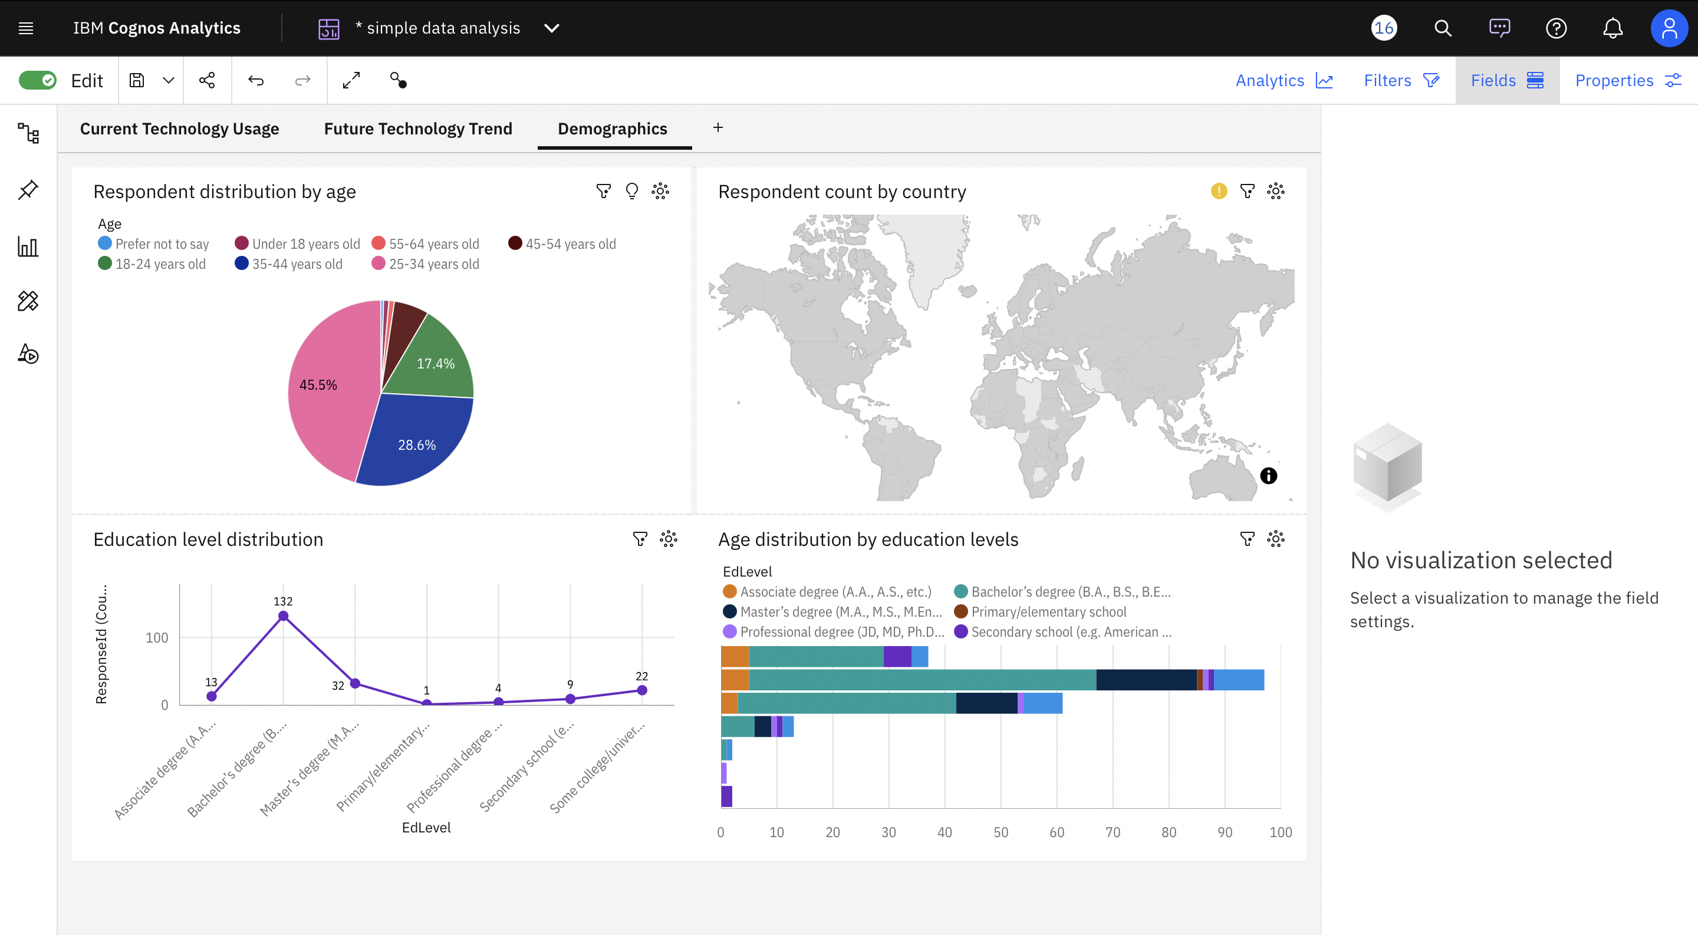
DASHBOARD TAB 3
Screenshot of dashboard tab 3 goes here

Slide 15
OVERALL FINDINGS & IMPLICATIONS
Findings
Programming Language Trends:
JavaScript and Python dominate both current usage and desired future adoption. Their versatility across various domains, such as web development and data analysis, makes them universally popular.
Database Preferences:
Relational databases such as MySQL and PostgreSQL remain highly used, with emerging demand for cloud-based and distributed databases like MongoDB.
Demographics Insights:
The majority of respondents are aged between 25-34 years, primarily holding bachelor's degrees, reflecting the young, educated workforce in the technology industry.
Implications
Implication for Businesses:
The widespread adoption of JavaScript and Python suggests companies should prioritize hiring or training employees proficient in these languages for long-term adaptability.
Implication for Cloud Providers:
The increasing demand for databases like MongoDB signals a growing shift towards distributed and scalable cloud-based solutions, pushing providers to enhance their offerings in this domain.
Workforce Strategy:
The predominance of young professionals implies the need for organizations to focus on engagement strategies, including continuous learning opportunities, to retain and nurture talent.

Slide 16

CONCLUSION
The Stack Overflow Developer Survey reveals that the developer community is predominantly composed of young professionals (aged 25–34) with a strong educational background, primarily Bachelor's and Master's degrees.
Current technology trends indicate that programming languages like Python, JavaScript, and SQL are highly favored, while future trends highlight growing interest in emerging technologies and languages like Go, Rust, and TypeScript.
Databases such as MySQL, PostgreSQL, and Microsoft SQL Server remain staples, but the survey shows increasing demand for NoSQL databases like MongoDB and cloud-based solutions in the near future.
The analysis underscores the importance of regional and demographic factors, such as geographic concentration and age distribution, in shaping developer preferences, emphasizing the need for targeted strategies to support diverse developer needs globally.

Slide 17
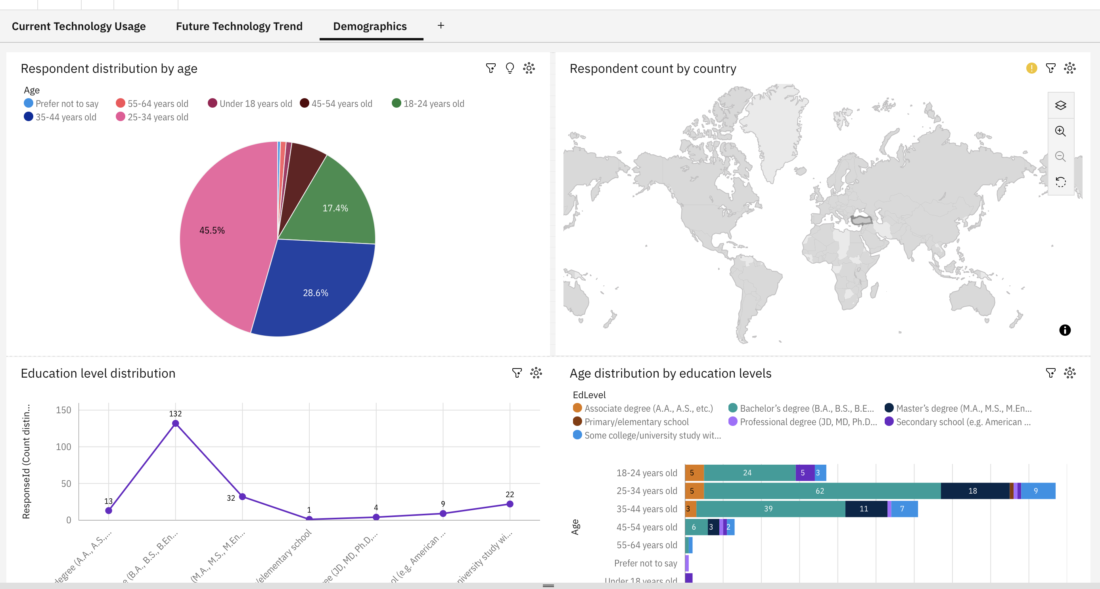
APPENDIX
Demographics Dashboard Overview
Respondent Distribution by Age (Pie Chart):
This chart shows the percentage of respondents categorized by their age groups.
Key insights:
The majority of respondents (45.5%) are aged between 25-34 years, highlighting that this age group dominates the survey population.
Other significant age groups include 35-44 years (28.6%) and 18-24 years (17.4%).
Older age groups, such as 45-54 years and 55-64 years, account for a smaller fraction of respondents.
Respondent Count by Country (Map Chart):
This map chart visualizes the geographic distribution of respondents by country.
The darker regions represent a higher number of respondents, while lighter regions represent fewer participants.
The map emphasizes the global reach of the survey, capturing responses from a variety of countries worldwide.
Education Level Distribution (Line Chart):
This chart shows the number of respondents grouped by their highest education level.
Key highlights:
The most common education level is a Bachelor’s degree (132 respondents), followed by Master’s degree (32 respondents).
Other categories, such as Associate degrees, Professional degrees, and Secondary school, represent fewer respondents.
Age Distribution by Education Levels (Stacked Bar Chart):
This visualization explores the relationship between age groups and their corresponding education levels.
Key insights:
Younger age groups, such as 18-24 years, are predominantly associated with ongoing or completed Bachelor’s degrees.
25-34 years show a diverse mix of education levels, with a strong emphasis on Bachelor’s and Master’s degrees.
Older age groups (e.g., 45-54 years and 55-64 years) lean more towards advanced degrees or professional certifications.

Slide 18
JOB POSTINGS
In Module 1 you have collected the job posting data using Job API in a file named “job-postings.xlsx”. Present that data using a bar chart here. Order the bar chart in the descending order of the number of job postings.

Slide 19
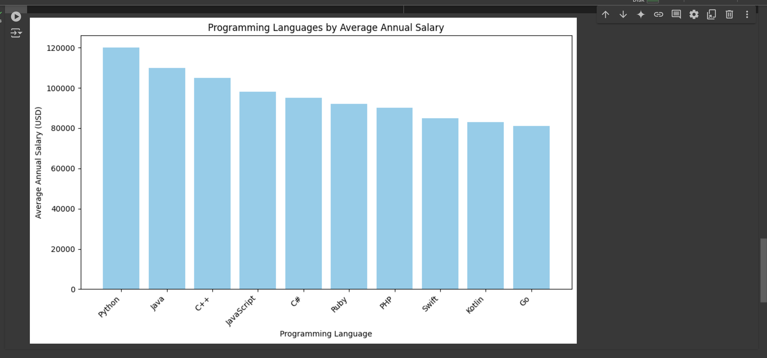
POPULAR LANGUAGES
In Module 1 you have collected the job postings data using web scraping in a file named “popular-languages.csv”. Present that data using a bar chart here. Order the bar chart in the descending order of salary.

